Slide 1
Probability EQ: What words can you use to describe situations involving chance?

Slide 2
24
7
30
Probability
Date
EQ – What words can you use to describe situations involving chance?
Probability is the chance that something will happen.
In everyday conversations we use words that indicate the chance or probability that something will happen.

Slide 3
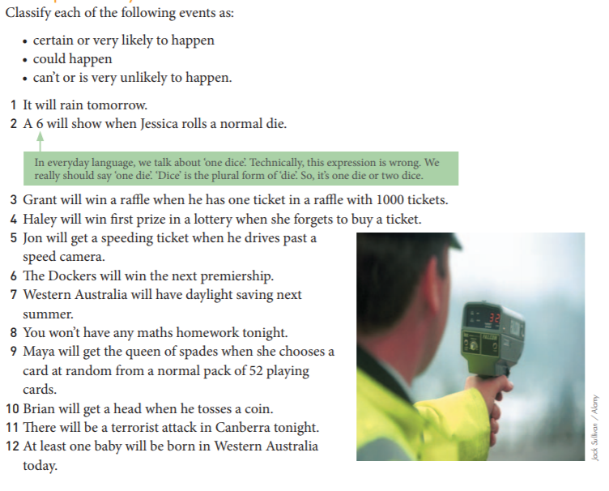
24
7
30
Probability
Date
EQ – What words can you use to describe situations involving chance?

Slide 4
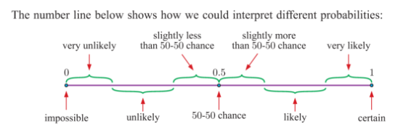
24
7
30
Probability
Date
EQ – What words can you use to describe situations involving chance?

Slide 5
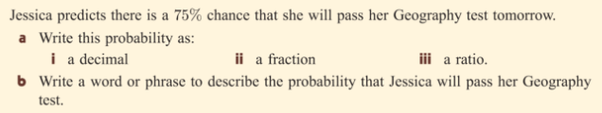

24
7
30
Probability
Date
EQ – What words can you use to describe situations involving chance?

Slide 6
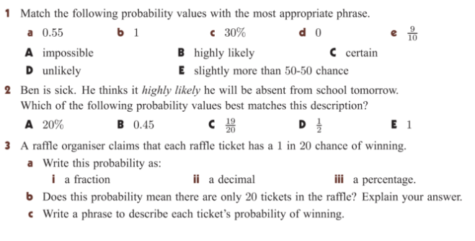
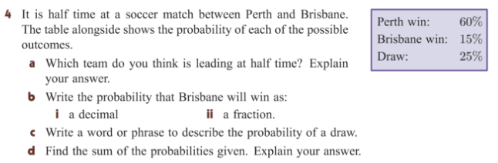
Practice Time:

